Slide 1
Passing Down Traits

Slide 2
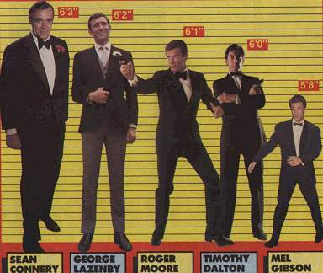
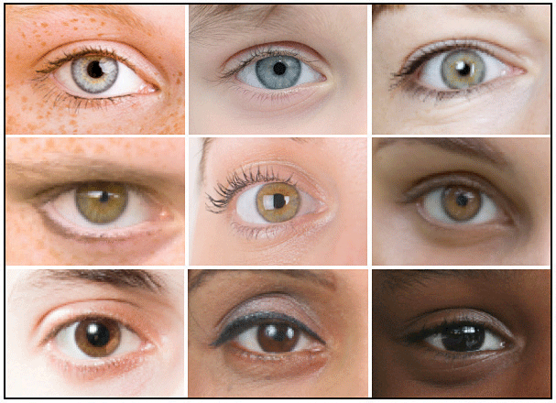
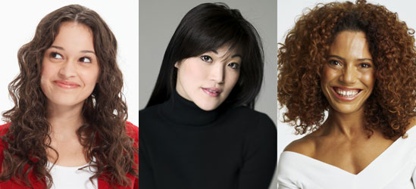
Traits
Inherited Traits
are determined by genes.
Most organisms have two sets of genes, one from each parent.

Slide 3
Genes have different forms
Most genes are either dominant or recessive.
We use letters to represent genes
CAPITAL LETTERS for DOMINANT GENES (ABC)
lower case letters for recessive genes (abc)

Slide 4
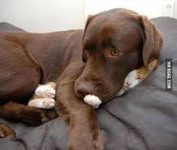
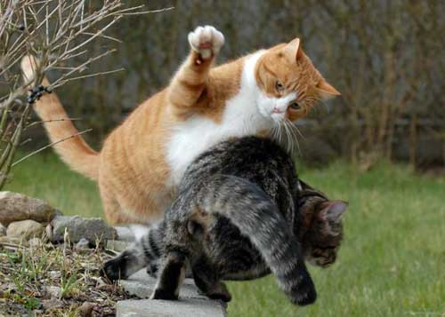
DOMINANT
A dominant gene will always be expressed whenever present in an organism.

Slide 5
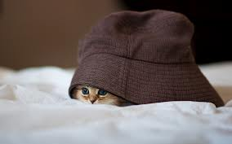
Recessive
A recessive gene can only be expressed when there is not a dominant gene.
They are hidden by dominant genes!

Slide 6
Genotype vs. Phenotype
Genotype is the genetic makeup, or what the genes are. They are written with CAPITAL or lowercase letters.
BB, Bb, bb
B=Black b=brown
Phenotype is what the trait looks like on the organism. It is the physical characteristic.
Black fur, brown fur, blue eyes, green eyes
Genotype -> -> -> Phenotype

Slide 7
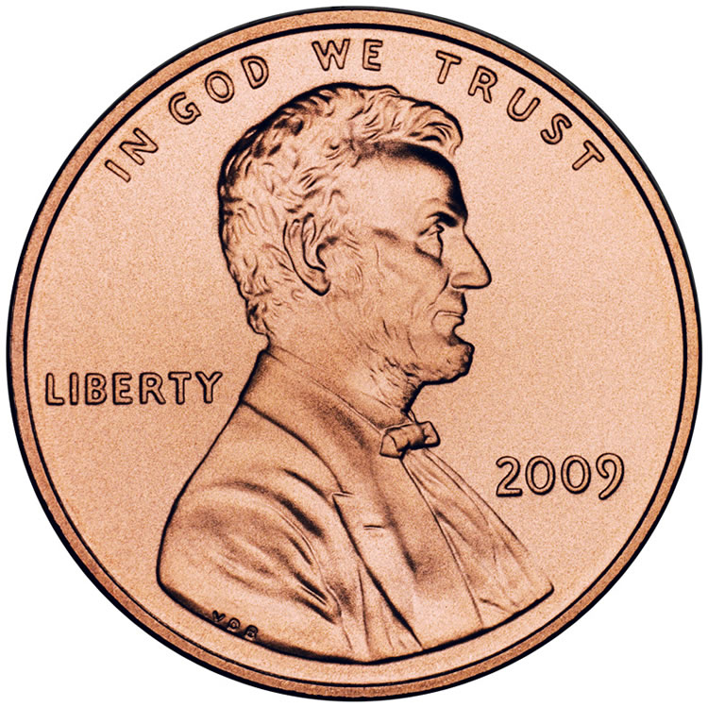
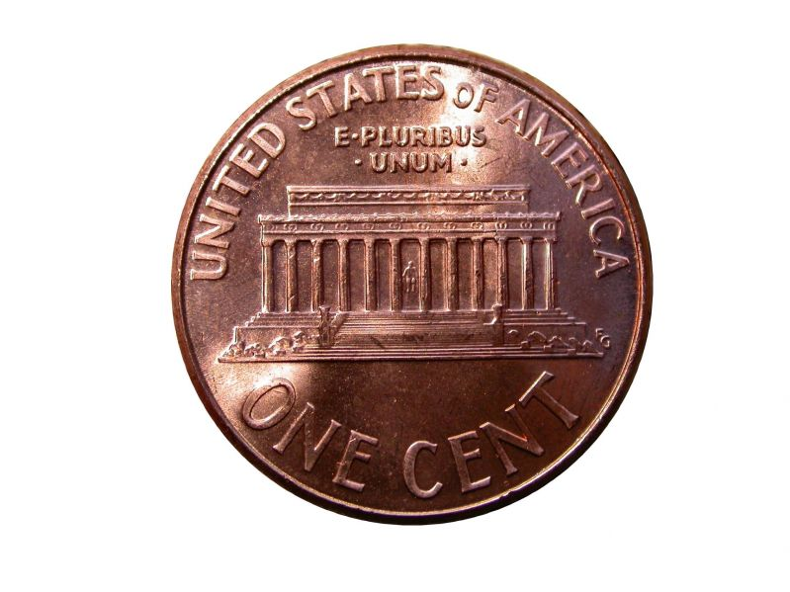
Let’s Try It!
= Dominant, represented by an ‘A’
= Recessive, represented by an ‘a’

Slide 8
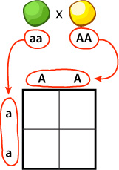
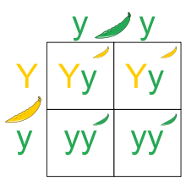
Punnett Squares
The Punnett Square is a diagram that helps us see the genetic possibilities of a breeding.
Put the genotypes of each organism around the block, and multiply!

Slide 9
Heterozygous/Homozygous
Heterozygous means the genotype is made of two different genes (or letters), a Dominant, and a Recessive. The Dominant gene is expressed.
Bb, Gg, Hh
Homozygous means the genotype is made of two of the same genes, two Dominants or two Recessives.
BB, bb, GG, gg, HH, hh

