Slide 1
Selective Breeding and Genetic Engineering

Slide 2
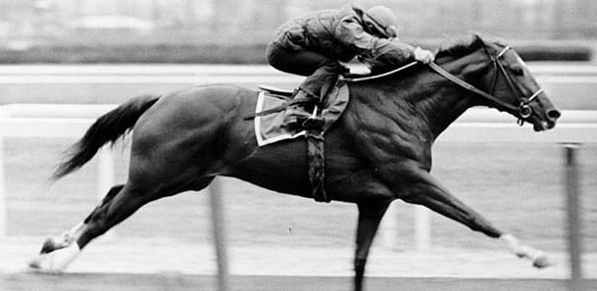
Desired Traits
Desired Traits:
Traits that are more favorable to the environment
and the artificial breeder.
Race Horses
Power to generate speed.
Stride to cover the ground.
Body weight to process energy

Slide 3
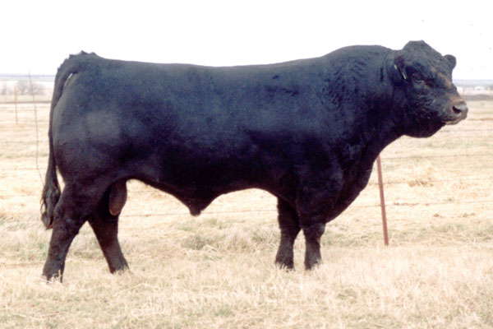
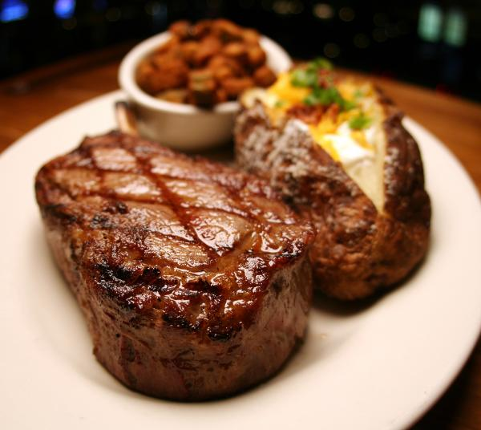
Selective Breeding
Selective Breeding:
The process of crossing two organisms with desired traits to get offspring with even more desirable traits.
Good Lean Meat

Slide 4
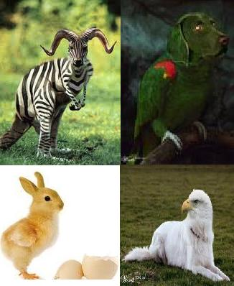
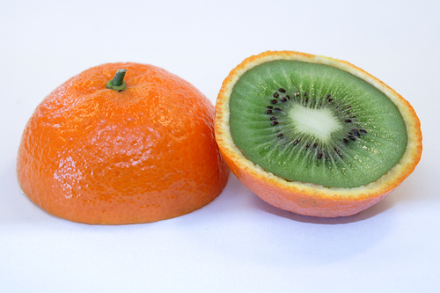
Genetic Engineering
Genetic Engineering:
The transfer of a gene from the DNA of one organism into another organism, in order to produce an organism with desired traits.

Slide 5
Selective Breeding
Native Americans transformed Teosinte (weed) into Maize over thousands of years.
By selectively choosing the best plants for human consumption (desired trait) they could harvest a lot of food for their family from a small area.
Native Americans
Teosinte changed to Corn

Slide 6
Teosinte to Maize to Corn
Corn Evolution
Amazing Difference!

Slide 7
Selective Breeding and Farming
By breeding dairy cattle with traits for heavy milk production, farmers create future generations of cows that produce more milk.
They also breed beef cattle with big muscles and lean in order to yield more meat.
Saving seeds from the best plants from year to year insures good food and more money.
Milk Cow

Slide 8
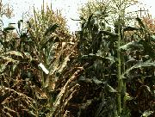
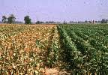
Disease Resistant Crops
Farmers selectively cross plants with desirable traits.
What are some desirable traits:
*drought resistant
*insect resistant
*longer ears of corn
*larger kernals….
Disease Resistant Corn

Slide 9
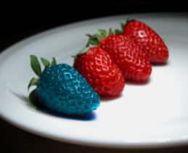
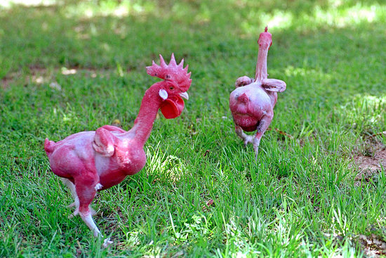
Genetic Engineering- What does it look like?
Do you think both colors taste the same?
If you’ve ever had to pluck a chicken, you might like this one.
Blue Strawberries
Featherless Chicken

Slide 10
12 Bizzare Examples of Genetic Engineering
http://www.mnn.com/green-tech/research-innovations/photos/12-bizarre-examples-of-genetic-engineering/pollution-fighting

Slide 11
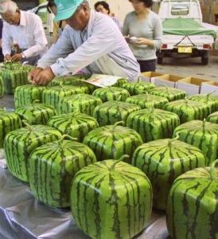
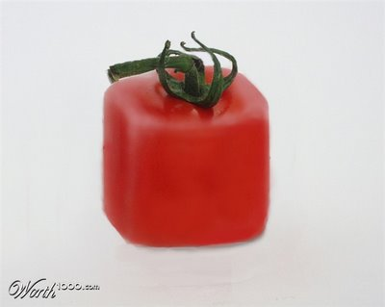
Square Fruits
Easy to package and ship.
Don’t roll off the counter.

Slide 12
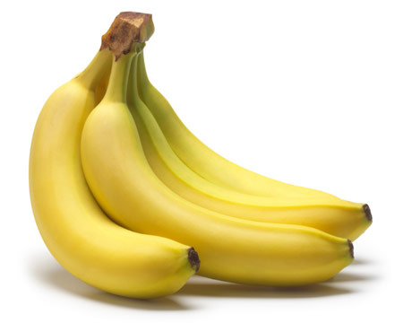
Medically
Scientists are testing several different crops for use as edible vaccines against a host of diseases.
Foods are good storage facilities, with sterile skins.
Vaccines in Food?
Bananas are already found in many countries

Slide 13
Good or Bad?
How are genetically modified foods good?
We can grow larger plants, and more meats.
We can make them grow faster.
Drought & Insect resistant plants.
Produce large volumes of medicines.
Micro-organisms that eat sewage & oil spills
Higher Yield.
Increased profit.
How are genetically modified food bad?
Doctors and scientists are finding an increase in allergies among people, some have linked it to GM foods.
Many studies are showing increased health problems among organisms that are fed strictly GM foods.
Good
Bad

Slide 14
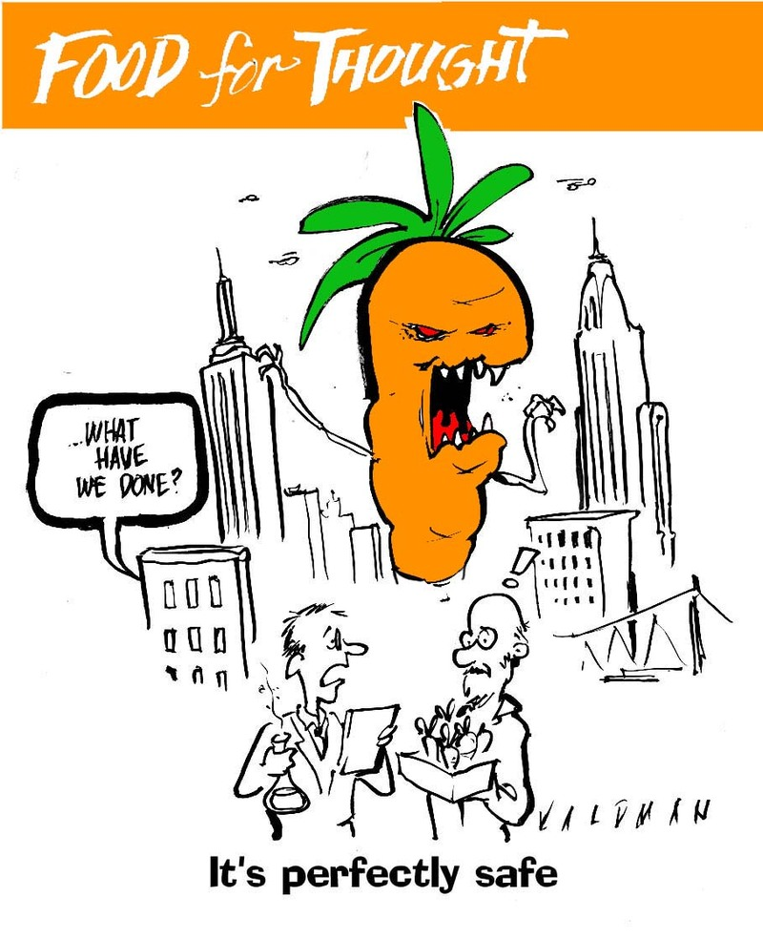
So… what do you think?
With scientists changing everything from sugar content, ripening cycles, and pest resistance in our foods.
Do you think this is healthy for us?
You decide…

